Slide 1
Semester: UG 2ND
CORE Paper III : Political theory- concept and debates
Unit: IV
Topic Name: Political Obligation
Course Teacher- Prof. Gyanaranjan Swain

Slide 2
Introduction to Political Obligation
Political obligation is the moral duty of citizens to obey the laws and support the government of the state in which they reside. Understanding the foundations of this obligation is crucial for maintaining a stable and legitimate political system.

Slide 3
Defining Political Obligation
Moral Duty
Legal Requirement
Civic Responsibility
Political obligation is a moral duty that arises from the social contract between citizens and the state. Citizens have a moral responsibility to obey the law and support the government.
Political obligation can also be seen as a legal requirement, where citizens are bound to obey the laws and institutions of the state by virtue of their citizenship.
Beyond moral and legal obligations, political obligation can be viewed as a civic responsibility to participate in the democratic process and contribute to the common good.

Slide 4
The Social Contract Theory
State of Nature
Legitimate Authority
In the social contract theory, individuals in a state of nature agree to surrender some of their freedoms to a central authority in exchange for security and order.
The social contract theory provides a justification for the legitimate authority of the state, which is derived from the voluntary consent of the governed.
1
2
3
Social Contract
The social contract is an implicit agreement between the citizens and the government, where the government agrees to protect the rights of the citizens in exchange for their obedience and loyalty.

Slide 5
Utilitarian Justifications for Political Obligation
1
Collective Welfare
2
Stability and Order
Utilitarians argue that political obligation is justified because it promotes the greatest good for the greatest number of people, leading to overall societal well-being.
Obedience to the state ensures social stability, law and order, and the protection of individual rights, which ultimately benefits everyone in society.
3
Efficient Governance
Political obligation allows for effective and efficient governance, enabling the state to coordinate and provide public goods and services more effectively.

Slide 6
Deontological Justifications for Political Obligation
Moral Duty
Categorical Imperative
Respect for Institutions
Deontological theories hold that individuals have a moral duty to obey the law and support the government, regardless of the consequences.
Kant's categorical imperative suggests that individuals should act in a way that they would will to become a universal law, which includes obeying the state.
Deontologists argue that individuals must respect the legitimate institutions of the state and fulfill their political obligations as a matter of moral principle.

Slide 7
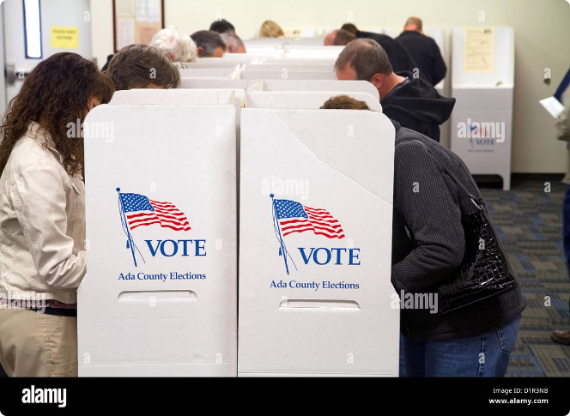
Consent and Political Obligation
Explicit Consent
Explicit consent, such as voting or actively participating in the political process, can create a stronger sense of political obligation.
Tacit Consent
Tacit consent, where individuals passively accept the state's authority by residing within its jurisdiction, can also generate political obligation.
Civic Engagement
Active civic engagement, such as volunteering or community service, can reinforce an individual's sense of political obligation and commitment to the state.

Slide 8
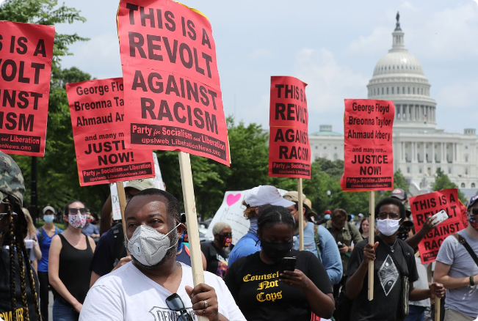
Challenges to Political Obligation
Duty vs. Consent
Dissent and Civil Disobedience
There is an ongoing debate about whether political obligation is grounded in moral duty or voluntary consent, which can lead to conflicting justifications.
The right to dissent and engage in civil disobedience can challenge the notion of unconditional political obligation, especially in cases of perceived injustice.
Global Citizenship
The increasing interconnectedness of the world and the rise of global governance structures can diminish the traditional concept of political obligation to a single state.

Slide 9
Conclusion and Implications
Key Takeaways
Implications
Political obligation is a complex concept with various theoretical justifications.
Understanding the foundations of political obligation is crucial for maintaining a stable and legitimate political system.
Consent, moral duty, and civic responsibility are important factors in shaping political obligation.
Navigating the balance between individual rights and social obligations is an ongoing challenge for governments and citizens.
Challenges to political obligation, such as dissent and global citizenship, continue to evolve.
Adapting the concept of political obligation to changing social and political realities is necessary for ensuring the long-term viability of the state.

